Slide 1
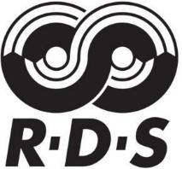
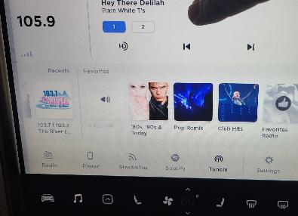
RDS Overview - What is the Radio Data System?
RDS is a system for transmitting small amounts of digital information along with FM radio broadcasts.
Information transmitted:
Program Service (PS): Displays the station's identiﬁer.
Radio Text (RT): Additional text information related to the broadcast content.
Clock Time: RDS can synchronize the clock of compatible receivers.
Frequency range (USA):
87.5MHz to 108.0 MHz.

Slide 2
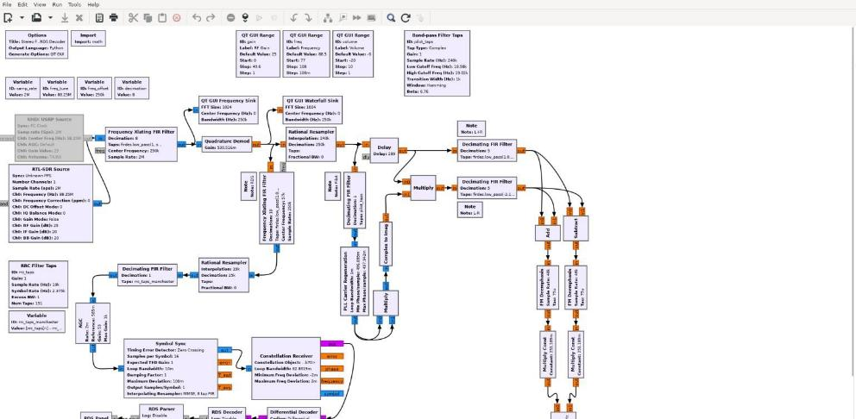
RDS – Receiving and decoding RDS
$ sudo xdg-open /usr/src/gr-rds/examples/rds_rx.grc Replace RTL-SDR Source with Osmocom source block

Slide 3
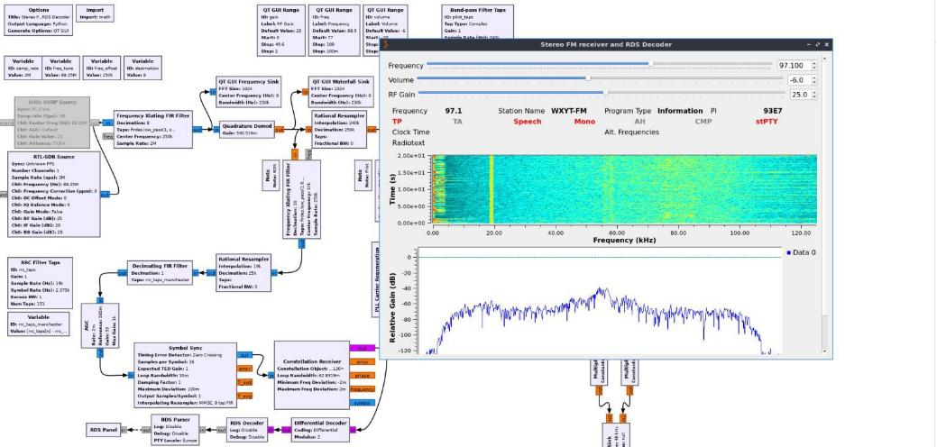
RDS- Receiving and decoding RDS continued

Slide 4
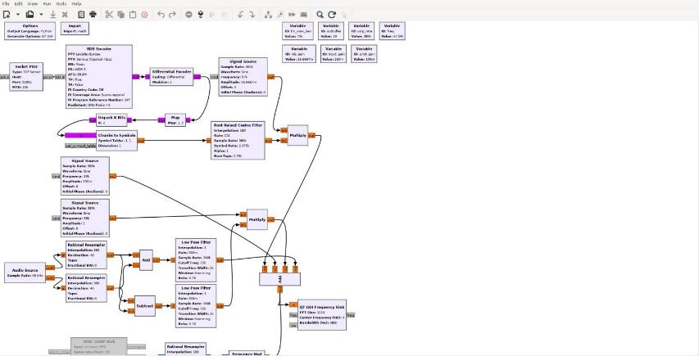
RDS – Transmitting RDS
$ sudo xdg-open /usr/src/gr-rds/examples/rds_tx.grc Adjust transmit frequency by modifying freq variable block

Slide 5
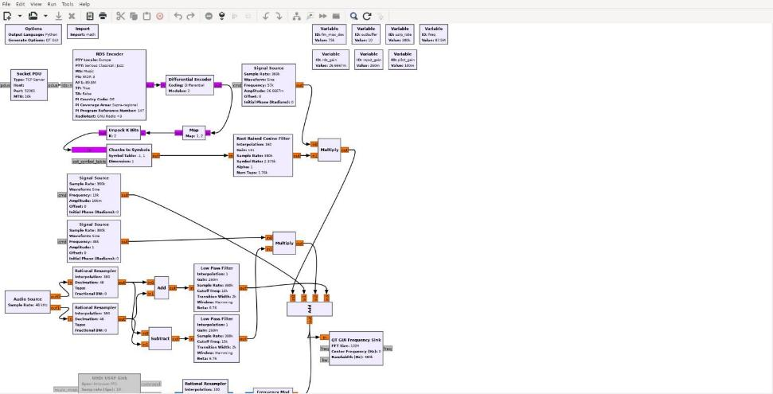
RDS – Transmitting RDS continued
Replace the Audio source block with a Wav ﬁle source and change ports to 2

Slide 6
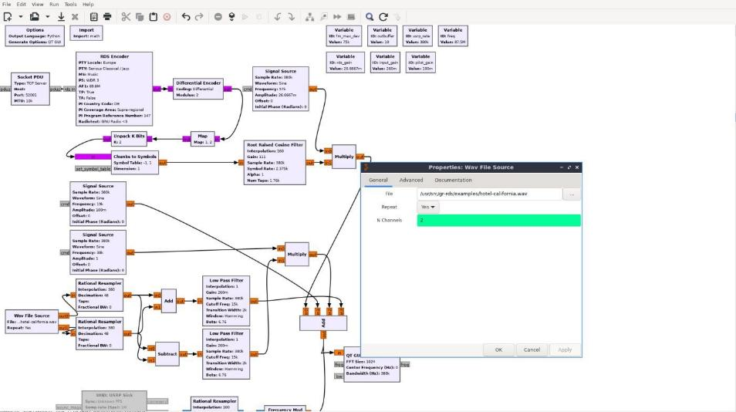
RDS – Transmitting RDS continued

Slide 7
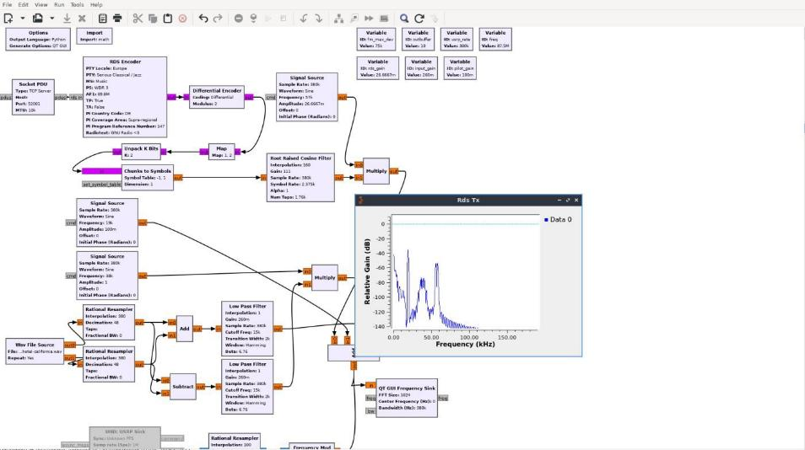
RDS – Transmitting RDS continued

